Slide 1


A Multi-User 360-Video Streaming System for Wireless Network
Haowei Cao, Jialiang Lu, Nan Zong
Paris-Tech Shanghai Jiao Tong University
Notes:
Good morning ladies and gentlemen! Here I am greatly honored to present you the research of our team. We are from ParisTech Shang hai Jiao Tong and our research “A Multi-User 360-video streaming system for wireless network”aims to provide a new method to optimize immersive video transmission.

Slide 2
Planning
Background
Our Work
Experiments & Results
Conclusion
Notes:
Here is the planning for the presentation which contains 4 parts:

Slide 3
Background
Limited Bandwidth & Latency
Redundant Viewport Transmission
Prior Works

Slide 4



=
Notes:
Lets start with this picture, i think this disappointment is shared by everyone when watching an online video and seeing a running circle here.

Slide 5
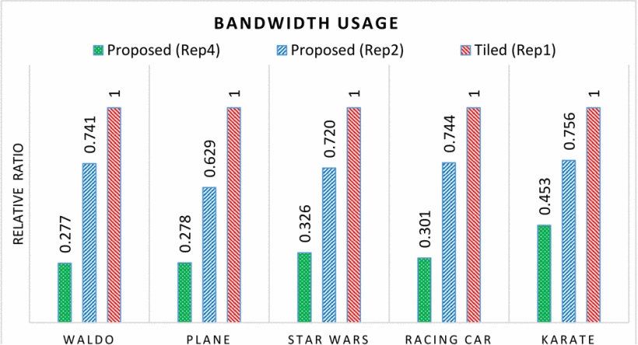
Background
Limited Bandwith & Latency
Large frame size
4-6 times the pixels of a regular video frame
Source: A comparison of bandwidth savings of streaming different 360 VR videos
View-aware tile-based adaptations in 360 virtual reality video streaming, Mohammad Hosseini ,University of Illinois at Urbana-Champaign (UIUC), Urbana, Illinois, USA
Notes:
We know the disappointment is caused mostly by Limited Bandwidth and Latency. Especially in 360 degree video, the pixels of a frame is 4-6 times larger than a regular cideo frame.

Slide 6
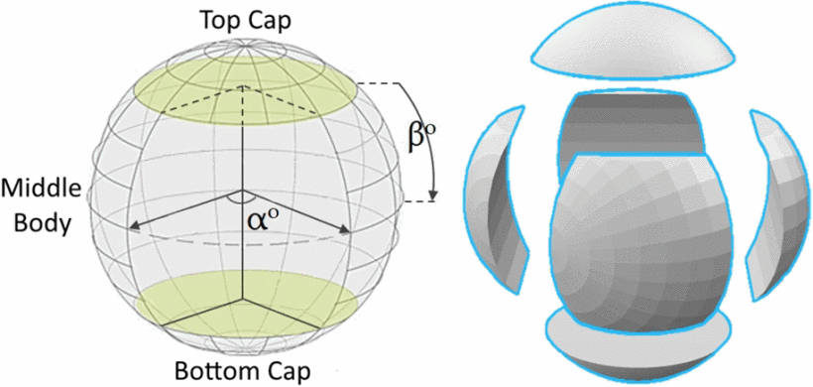
Background
Redundant Viewport Transmission
Small visible portion
"20 %" Viewport by user
User View
Source: A comparison of bandwidth savings of streaming different 360 VR videos
View-aware tile-based adaptations in 360 virtual reality video streaming, Mohammad Hosseini ,University of Illinois at Urbana-Champaign (UIUC), Urbana, Illinois, USA
Notes:
Secondly, the problem occurs on the redundant viewport transmission. People only use 20% of the sphere viewport because of the limited FOV, but in real life the video is 100% transmitted to the user as the user's following sight position is unknown.

Slide 7
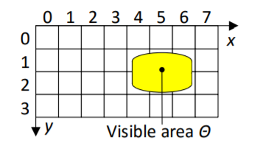
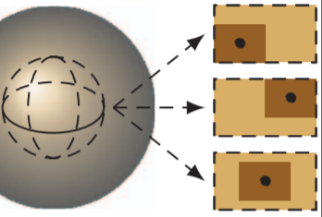
Background
Prior Works
Viewport-adaptive delivery
Based on pre-segmented tiles
Based on Quality Emphasized Region
[Qian et al. 2016]
[Corbillon et al. 2017]
Notes:
Thus, there were two works done to optimize those probelms. First, Qian in 2016 did a research based on pre segmented tiles, by which only visible area of the video is transmitted. Then in 2017 Corbillon used a quality emphasized region methode to lower the useless parts of the video to save net resources.

Slide 8
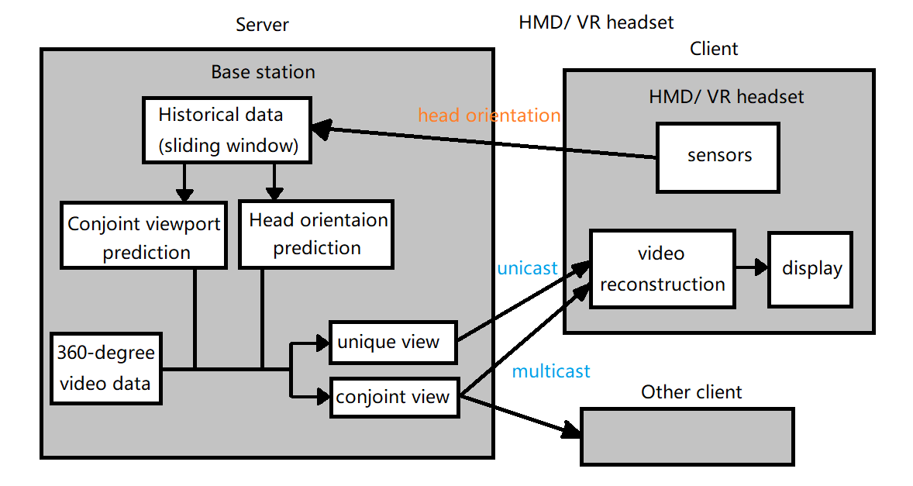
Our work
A Multi-user 360-video streaming system on wireless network
Notes:
Here, our works constructed a structure to optimize one step furthur, and here is the system structure:
First the client send the request as well as the Head orientation data from HMD sensors to the Server.
Then before sending the video clip, the server will use 2 prediction models to predict the conjoint view and head orientations of users.
Finally, the video data will be sent seperately : the unique view will be unicasted to the sepecific client, and the conjoint part will be multicasted to all the users, thus can save transmission costs.

Slide 9
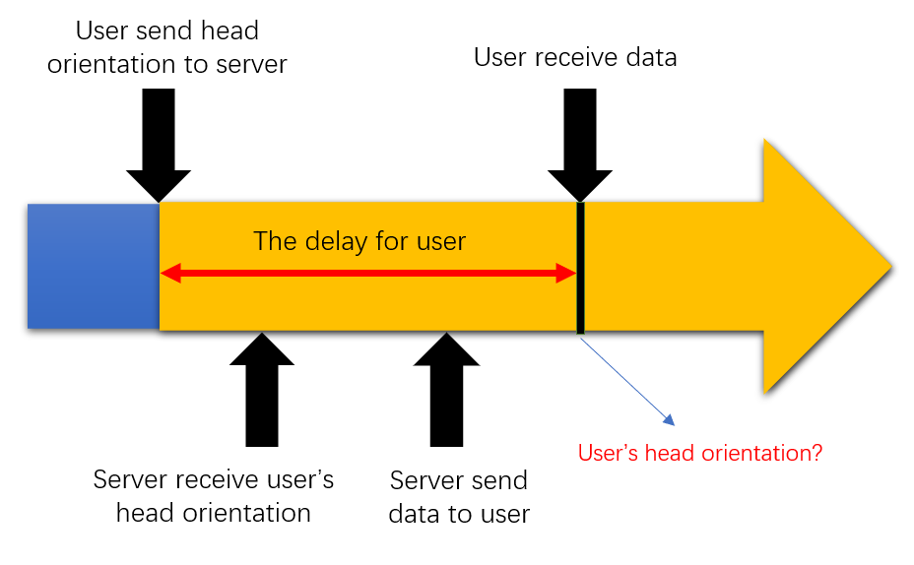
Our work
Head movement prediction
Total Delay of Transmission:
20 ~ 300 ms
Our prediction interval:
100 ms after request sent
Notes:
In our structure, the prediction parts are the main points of work.
First, we applied a Head movement prediction, which can predict the user's head orientation after the total delay of video transmission. The delay is about 20-3000 ms.
This is how we can predict which part should be unicasted to a certain user.

Slide 10
Our work
Head movement prediction
Input:
User's head orientation during a period of time in the past
Output:
User's head orientation after the prediction interval (delay time)

Slide 11
Our work
Head movement prediction
Machine learning models
Linear Regression
Fitting a linear equation to data
Easy to implement
Working fine for short time delay
Long Short-Term Memory (LSTM)
A recurrent neural network with hidden states
Efficient for dealing with sequences (time series data)
Notes:
Here we used Linear Regression and LSTM to do the prediction.
LR because of its Easiness to implement and a relatively good accuracy.
LSTM because it is efficient for dealing with time series data, which matches exactly our data property.

Slide 12
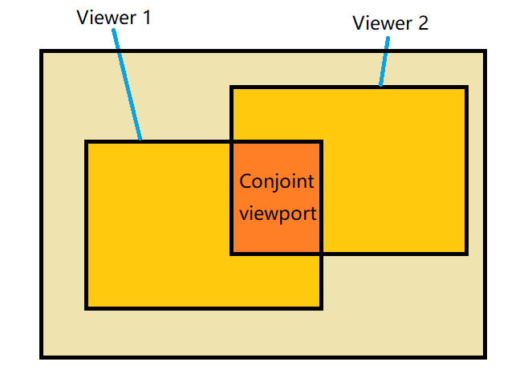
Our work
Conjoint viewport prediction
The region of video frame which is visible to multiple users at a given time
Transmitted in public channel (multicasting)
Notes:
Then we defined the conjoint viewport : the region of video which is visible and conjoint to multiple users at a given time.
This part will be transmitted in public channel once for all users.

Slide 13
Our work
Conjoint viewport prediction
Input:
Head orientation of all users during a time period in the past
Output:
Whether there is a conjoint viewport among the users
Machine learning model: LSTM

Slide 14
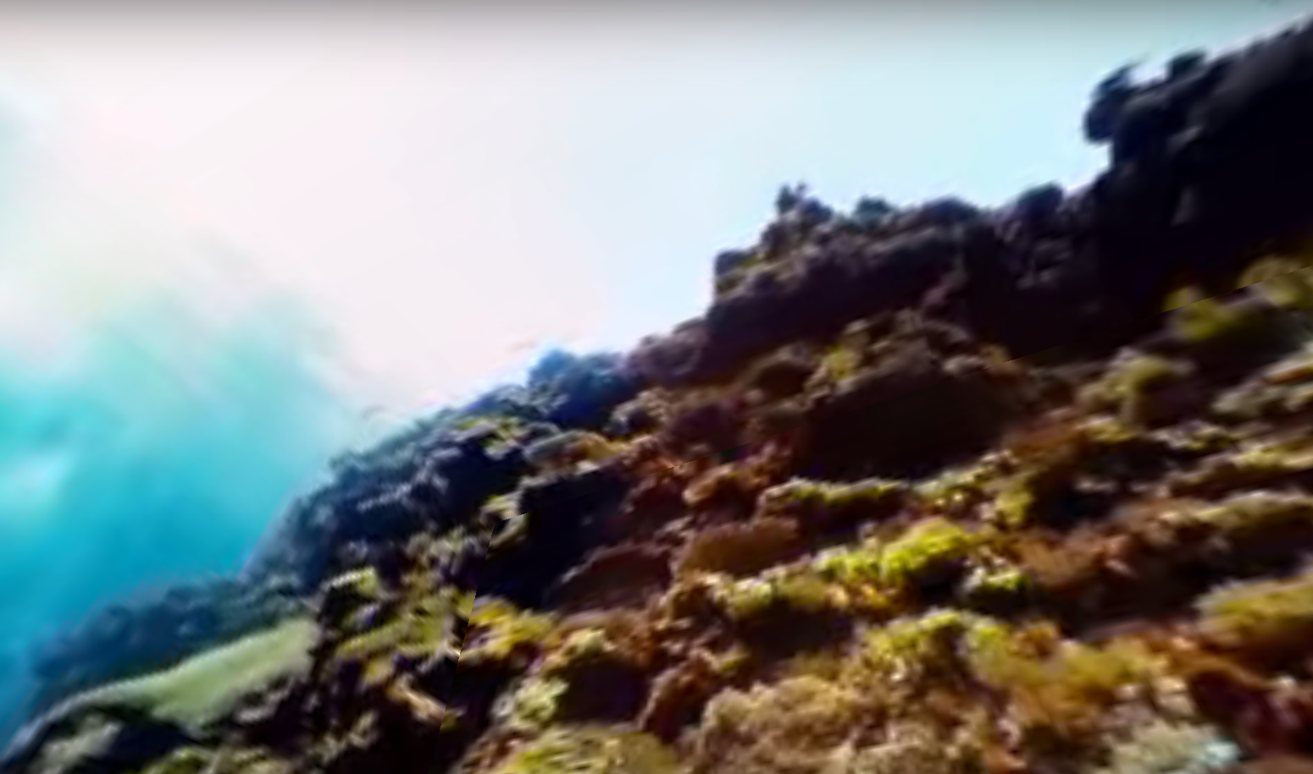
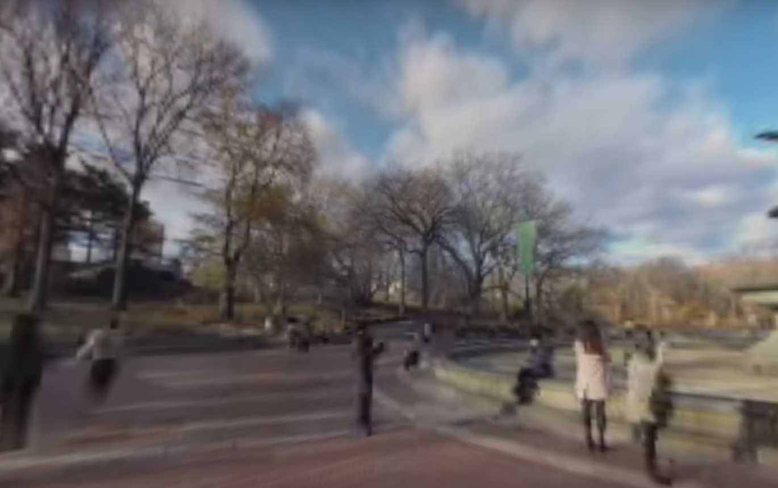
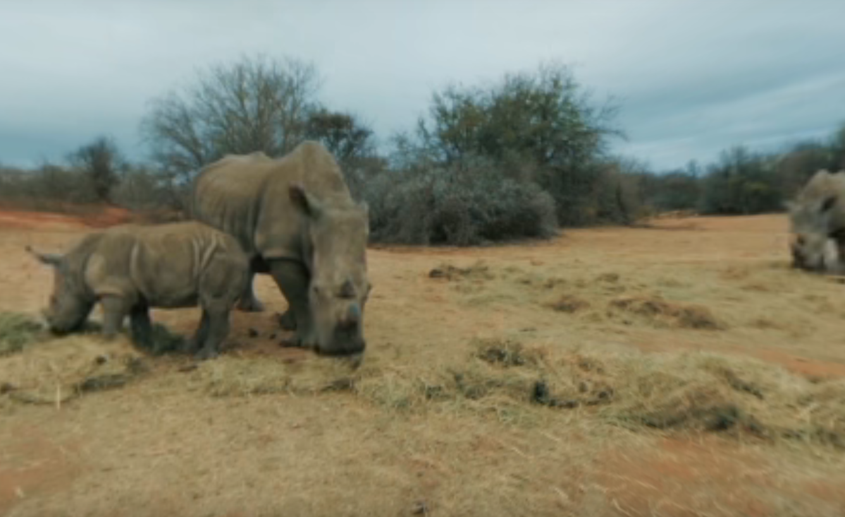
Experiments
Datasets
provided by Corbillon et al., 360-Degree Video Head Movement Dataset
Configurations
input head orientation in past 2 seconds
30 samples per second
prediction after 100 ms
Notes:
Then, after having built up the general pattern, we did experiments with our system.
The dataset contains the head movements of 63 viewers watching 7 different 360-degree videos.
The head orientation of viewer is captured 30 times every second and is stored in the form of quaternion.
We processed the dataset and converted quaternion to Euler angles which is used in our models.

Slide 15
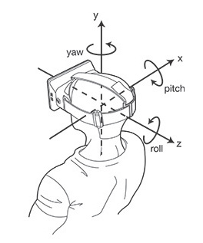
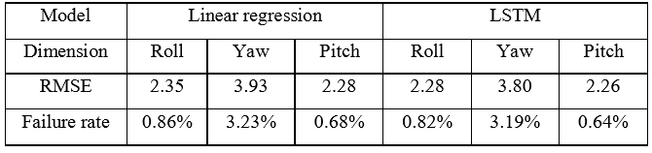
Results
Head orientation model
Yaw is more errorprone
LSTM performs just slightly better than LR
Head movement is linearly correlated in short term as time-related sequences
Notes:
To evaluate the performance of the models, we used two indicators: root mean square error, and failure rate which represents the percentage of prediction with an error larger than 10 degrees.

Slide 16
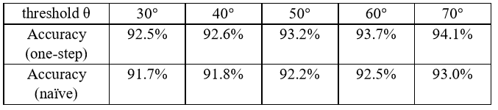
Results
Conjoint view model (2 users)
Threshold θ is the maximum angle difference which defines a conjoint area.
One-step performs slightly better than Naive method.
Models Judgement VS. Manual Judgment
Notes:
Here, we assume that a conjoint viewport exists if the differences of yaw and pitch between the users are less than a certain threshold θ = θy, θp
In order to estimate our model (which we call one-step method), we also implemented a naive method for comparison: the naive method will first predict the future head orientation of the users (which is already done in section 4.1), and then calculate differences between the predicted orientations to judge whether there will be a conjoint viewport.

Slide 17
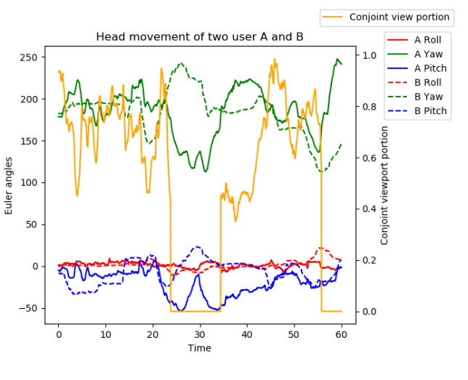
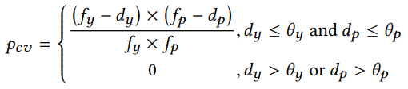
Results
Conjoint proportion estimation
Proportion calculated by:
Results:
Conjoint proportion during the whole play is generally high.
Feasible to save bandwidth by multicasting the conjoint view port.
Notes:
Conjoint proportion during the whole play is generally high because viewers’ regions of interest are similar, thus it is feasible to save bandwidth by multicasting the conjoint view port.

Slide 18
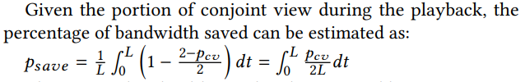
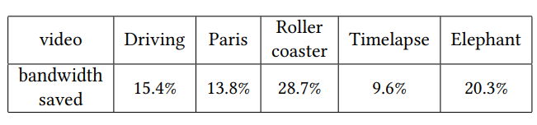
Results
Bandwidth saved
A noticable economization of bandwidth

Slide 19
Conclusion
1. Research Subject :
360-degree Video Transmission Optimization
2. Methodology :
Head orientation prediction : LR + LSTM
Conjoint viewport prediction : LSTM
3. Results :
High precision of prediction
Noticable bandwidth saved
4. Future work:
Focus on multi-users (more than 2)
Different prediction time intervals
Notes:
Becasue the more users we have , the less transmisson of conjoint viewport is needed.

Slide 20
Thanks For Listening!
Please be free to contact us:
chw0239@163.com cisnazong@sjtu.edu.cn

